Slide 1

SMART GRID OPTIMIZATION USING MACHINE LEARNING: ENHANCING EFFICIENCY, STABILITY, AND PREDICTIVE MAINTENANCE
SRM INSTITUTE OF SCIENCE AND TECHNOLOGY
SCHOOL OF COMPUTING
DEPARTMENT OF COMPUTING TECHNOLOGIES
18CSP107L / 18CSP108L - MINOR PROJECT / INTERNSHIP
Student 1 Reg. No:RA2111003011348
Student 1 Name: JANI KG
Student 2 Reg. No:RA2111003011381
Student 2 Name: YOSHITHA J
Guide name :Dr . Lavanya R
Designation :Assistant Professor Department : C-TECH

Slide 2
ABSTRACT
This project explores methods to enhance the stability of the Smart Grid, a modernized electrical grid incorporating advanced information and communication technologies.
By addressing the challenges of integrating renewable energy sources and managing decentralized power generation, the project aims to ensure reliable and efficient electricity distribution.
Key objectives include developing real-time monitoring systems, predictive analytics, and advanced control strategies.
These technologies will help detect and mitigate potential grid disturbances, optimizing energy flow and preventing outages.
The project ultimately seeks to contribute to a more resilient and sustainable energy infrastructure, capable of adapting to the dynamic demands of modern electricity consumption.

Slide 3
INTRODUCTION
The Smart Grid is a modern electric power system that integrates advanced technologies for monitoring and managing electricity flow.
Unlike traditional grids, it utilizes sensors, communication networks, and data analytics to optimize energy distribution, improve reliability, and accommodate renewable energy sources.
This system is designed to meet the evolving demands of energy consumption and production, offering increased efficiency and flexibility.
The Smart Grid aims to enhance the overall stability and sustainability of the electrical grid in the face of modern challenges.

Slide 4
PROBLEM STATEMENT
The challenge lies in maintaining Smart Grid stability amid growing complexities, including renewable energy integration and fluctuating demand.
This project seeks to identify and mitigate potential stability issues, ensuring a reliable and resilient power system capable of handling modern energy challenges.

Slide 5
MOTIVATION
Increasing electricity demand, coupled with the integration of renewable energy sources, presents challenges to grid stability.
These challenges drive the need for advanced solutions that ensure reliable energy delivery, prevent outages, and manage the complexities of a decentralized and dynamic energy supply.

Slide 6
OBJECTIVES OF THE PROJECT
Seamlessly integrate renewable energy sources into the grid.
To understand and enhance grid stability.
Compare the different ML Algorithms for anticipating disturbances.
Conclude which algorithm gives the highest accuracy .
Use real time load forecasting, anomaly detection, and predictive maintenance.

Slide 7
EXISTING SYSTEM
The existing power grid infrastructure is largely outdated, designed for centralized power generation and limited in handling modern energy demands.
It struggles with integrating renewable sources and managing distributed generation, making it less efficient and more prone to instability.

Slide 8
PROPOSED SYSTEM
The proposed system involves real-time monitoring, predictive analytics, and advanced communication protocols.
It aims to enhance grid stability by integrating renewable energy sources, using machine learning for predictive maintenance, and implementing robust data exchange mechanisms for efficient decision-making.

Slide 9
DISADVANTAGES OF EXISTING SYSTEM
Limited to specific EV charging patterns
Limited to specific renewable energy types
Requires advanced communication infrastructure
Reliance on high quality data
Limited to specific distributed energy resourses types and configuration

Slide 10
SCOPE OF THE PROJECT
This project focuses on developing and testing algorithms and technologies for Smart Grid stability.
It includes real-time monitoring, predictive analytics, and control strategies.
The scope extends to integrating renewable energy and addressing the impact of distributed generation on grid stability.

Slide 11
LITERATURE SURVEY
S.No | Title | Year | Objective | Methodologies | Limitations
1 | "Stability Analysis of Smart Grid With High Penetration of Renewable Energy Sources" | 2021 | To analyze grid stability with high renewable integration | Lyapunov stability theory, Monte Carlo simulations | Limited to specific renewable energy types
2 | "Machine Learning-Based Approach for Real-Time Stability Assessment in Smart Grids" | 2022 | To develop a real-time stability assessment tool | Support Vector Machines, Random Forests | Requires large datasets for training
3 | "Decentralized Control Strategy for Enhancing Smart Grid Stability" | 2021 | To propose a decentralized control method for improved stability | Model Predictive Control, Distributed Optimization | Assumes perfect communication between nodes
4 | "Impact of Electric Vehicle Integration on Smart Grid Stability" | 2023 | To evaluate the effects of EV charging on grid stability | Power flow analysis, Stochastic modeling | Limited to specific EV charging patterns
5 | "Robust Stability Analysis of Microgrids in Smart Grid Environment" | 2022 | To develop a robust stability analysis framework for microgrids | H-infinity control, Small-signal stability analysis | Computationally intensive for large-scale systems

Slide 12
LITERATURE SURVEY
S.No | Title | Year | Objective | Methodologies | Limitations
6 | "Data-Driven Stability Assessment for Smart Grids Using Phasor Measurement Units" | 2023 | To create a data-driven stability assessment method using PMU data | Machine learning, Phasor analysis | Reliance on high-quality PMU data
7 | "Adaptive Protection Schemes for Enhancing Smart Grid Stability" | 2021 | To design adaptive protection schemes for improved grid stability | Adaptive relaying, Wide-area monitoring | Requires advanced communication infrastructure
8 | "Voltage Stability Enhancement in Smart Grids Using Distributed Energy Resources" | 2022 | To improve voltage stability through optimal DER placement and control | Particle Swarm Optimization, Voltage Sensitivity Analysis | Limited to specific DER types and configurations
9 | "Resilient Control Strategies for Smart Grid Stability Under Cyber-Physical Attacks" | 2023 | To develop resilient control methods against cyber-physical attacks | Game theory, Robust control | Assumes specific attack models
10 | "Dynamic Stability Assessment of Smart Grids with High Wind Power Penetration" | 2021 | To assess dynamic stability in grids with high wind power integration | Eigenvalue analysis, Probabilistic approaches | Focused primarily on wind power integration

Slide 13
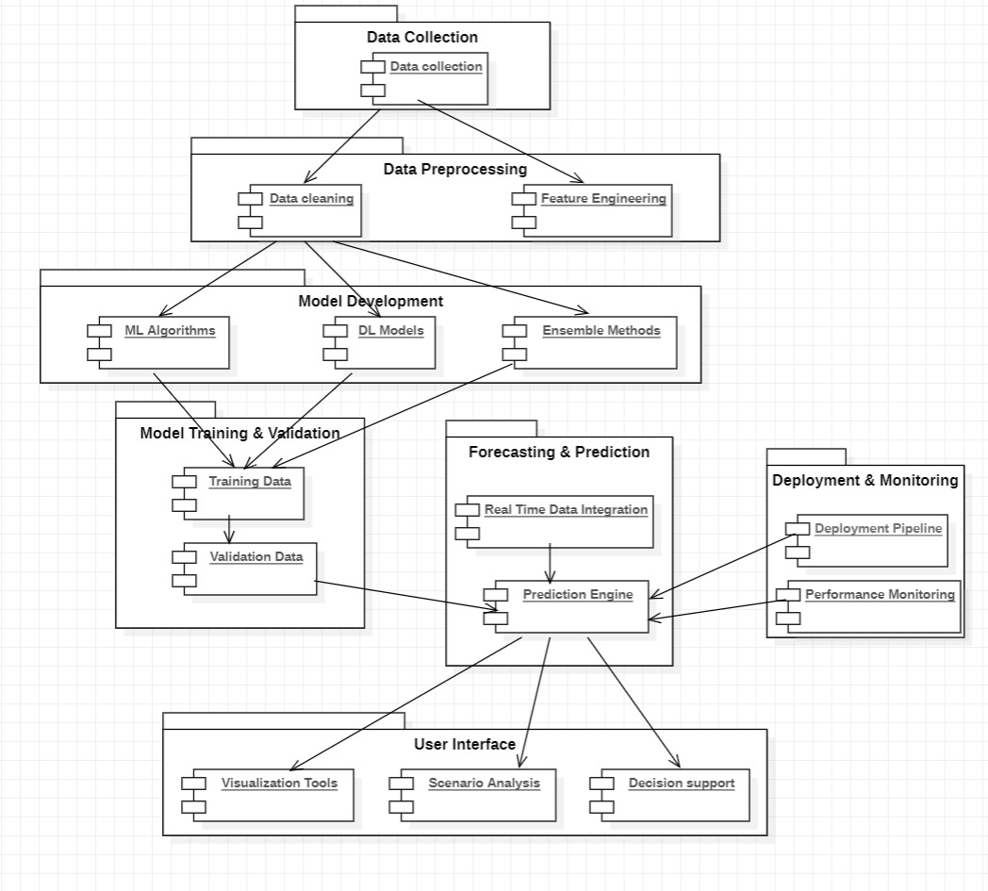
ARCHITECTURE DIAGRAM

Slide 14

ALGORITHM USED:
Random Forest:
Random Forest is an ensemble learning method that operates by constructing multiple decision trees during training.
It aggregates the results of these trees to improve the overall prediction accuracy and robustness.
Application in Smart Grid Optimization:
Ideal for predicting various grid parameters such as load demand and failure probability.
Useful for feature selection and handling large datasets with multiple features.
Advantages:
High accuracy and robustness due to ensemble learning.
Handles missing data effectively and reduces overfitting.
The model provides feature importance scores, which are useful in understanding which factors influence grid performance the most.

Slide 15
2. Decision Tree Classifier:
Decision Tree is a non-parametric supervised learning algorithm used for classification and regression.
It splits the data into subsets based on the value of input features, creating a tree-like model of decisions.
Application in Smart Grid Optimization:
Useful for simple classification tasks, such as identifying critical grid components that may fail.
Provides clear and interpretable decision paths for maintenance and operational decisions.
Advantages:
Easy to understand and interpret results.
Can handle both numerical and categorical data.
Decision Trees can be visualized to understand the decision-making process clearly.

Slide 16
3. SVM:
SVM is a supervised machine learning algorithm used for classification and regression tasks.
It works by finding the optimal hyperplane that separates different classes in the feature space.
SVM is effective in high-dimensional spaces and is particularly useful for binary classification problems.
Application in Smart Grid Optimization:
Used to classify grid stability status (stable/unstable) based on real-time data.
Helps in predicting maintenance needs by identifying patterns in grid performance data.
Advantages:
High accuracy in complex datasets.
Robust to overfitting, especially in high-dimensional space.

Slide 17
4. X G Boost Classifier:
X G Boost is an advanced implementation of the gradient boosting algorithm, known for its high performance and speed.
It works by building an ensemble of trees sequentially, where each new tree corrects the errors of the previous ones.
Application in Smart Grid Optimization:
Applied to predictive maintenance by identifying and predicting failures with high accuracy.
Useful in optimizing energy distribution and predicting demand, thereby enhancing grid efficiency.
Advantages:
Superior performance in terms of both accuracy and speed.
Handles missing data and has built-in regularization, reducing overfitting.

Slide 18

5. Long Short Term Memory
A type of RNN that handles sequence prediction. Overcomes the vanishing gradient problem in standard RNNs. Contains memory cells and gates (input, forget, output) to manage information flow.
Applications in Smart Grid Optimization
Load Forecasting: Predicts electricity demand for efficient generation and distribution.
Forecasts renewable energy production for better grid balance.
Detects and predicts grid anomalies for preemptive maintenance
Advantages of LSTM
Captures long-term dependencies in data.
Robust against noise .
Scalable for large datasets.

Slide 19
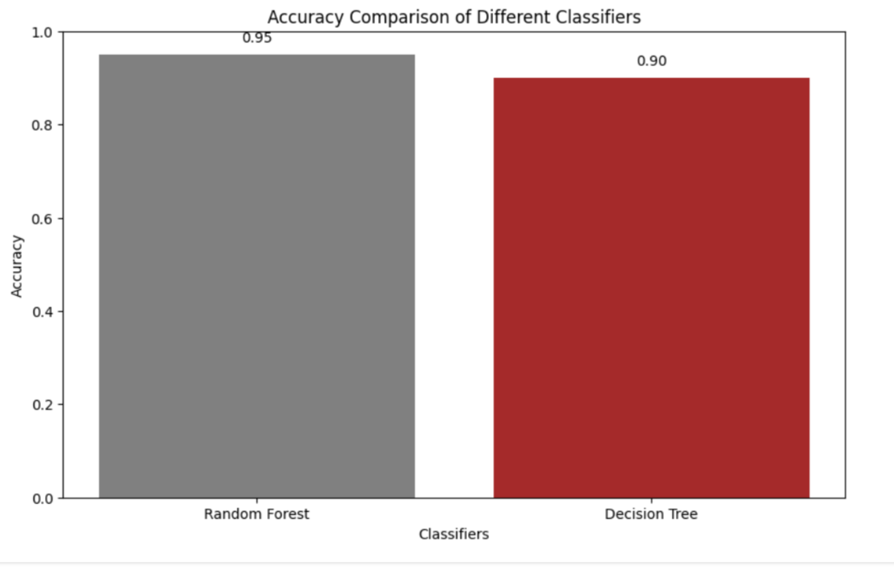
ACCURACY OF ALGORITHMS:
Random Forest and Decision Tree

Slide 20
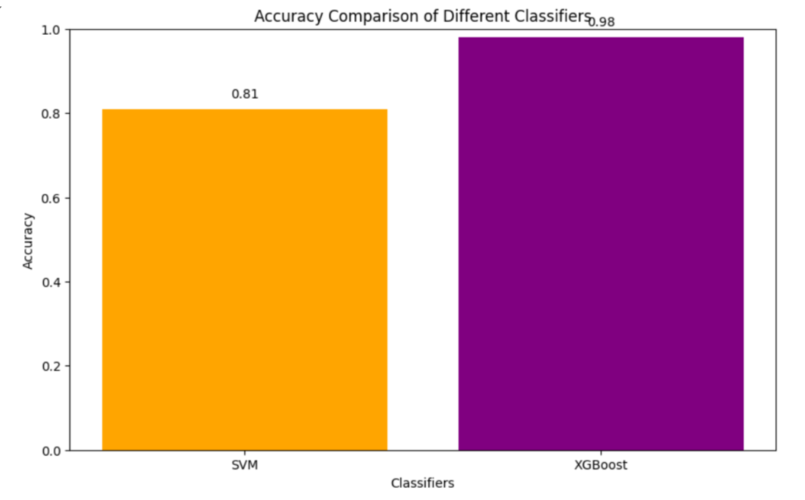
SVM and XG Boost

Slide 21
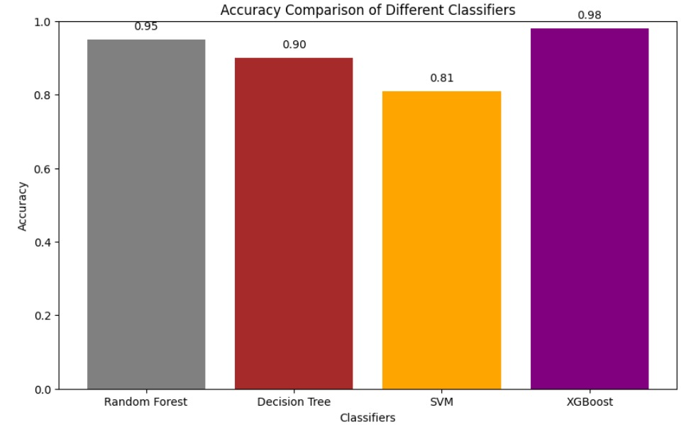
ACCURACY OF ALGORITHMS:

Slide 22
COMPARISION OF ALL ALGORITHMS:

Slide 23
FUTURE ENHANCEMENT
Future enhancements for smart grid stability include integrating advanced data analytics to predict issues and detect anomalies, deploying more granular sensors with edge computing, and leveraging 5G for faster, secure communication.
Emphasis on advanced energy storage solutions, dynamic grid management, and the integration of renewable energy sources is crucial.
Automated systems for self-healing grids and demand response, along with AI-driven adaptive controls and better visualization tools, will further improve grid reliability and efficiency.

Slide 24
CONCLUSION
The integration of machine learning into smart grid systems offers transformative potential for enhancing efficiency, stability, and predictive maintenance. This project has demonstrated that advanced machine learning techniques can significantly improve grid performance by optimizing energy distribution, detecting and mitigating anomalies, and forecasting equipment failures with greater accuracy.
The application of machine learning algorithms enables real-time load forecasting, allowing for more efficient energy management and reduced operational costs. By leveraging models such as deep learning and reinforcement learning, the project has shown that smart grids can better handle the complexities of modern energy demands and the integration of renewable sources. Furthermore, the use of machine learning for anomaly detection enhances grid stability by identifying potential disruptions before they escalate into major issues.

Slide 25
Predictive maintenance, powered by machine learning, contributes to the overall reliability of the smart grid by enabling timely interventions and minimizing downtime. This proactive approach not only extends the lifespan of critical infrastructure but also reduces maintenance costs and prevents unexpected failures.
In conclusion, the project highlights the significant benefits of incorporating machine learning into smart grid management. It paves the way for more resilient, efficient, and adaptive energy systems, aligning with the growing demand for sustainable and reliable energy solutions. Future research and development in this field will continue to build on these advancements, further optimizing smart grid operations and supporting the transition to a more intelligent and responsive energy infrastructure.

